Slide 1


Final Review
Nan Muthalvan – Niral Thiruvila Project Review
Dr. Mahalingam College of Engineering and Technology
Pollachi, Tamilnadu, India
AgroAid: A Multilingual AI-Based Support Bot for Small-Scale Farmers
Guided by
Submitted by
Mr. Dhyaneswaran J
Assistant Professor
Information Technology
Bharath Kumar N - 727621BIT064
Naveen V C - 727621BIT074
Dinesh M - 727622BIT320

Slide 2
OUTLINE
Project Title
Abstract
Literature review
Existing system
Drawbacks in Existing System
Proposed system and its advantages
Tool(s) used for implementation
Result
References
2

Slide 3
Project Title
AgroAid: A Multilingual AI-Based Support Bot for Small-Scale Farmers

Slide 4
Abstract
Objective: To develop a software-based AI-powered support system to assist small-scale farmers in improving agricultural productivity and decision-making.
Purpose: To overcome challenges in soil health prediction, pest detection, irrigation planning, and access to government schemes using Machine Learning and Natural Language Processing (NLP).
Core Features:
Soil Fertility Prediction: Predict suitable crops and fertilizers using ML models trained on soil datasets.
Pest and Disease Detection: Detect crop diseases using computer vision models trained on labeled image datasets.
Irrigation Planning: Suggest optimal irrigation schedules based on crop lifecycle and environmental datasets.
Harvest Time Prediction: Use ML algorithms to recommend ideal harvesting periods for yield maximization.
Scheme Recommendation: Guide farmers with relevant government schemes and subsidies using filtering logic.
Multilingual Interaction: Provide voice/text-based support in multiple local languages using NLP and Text-to-Speech APIs.
4
Notes:
4

Slide 5
Existing System
The current agricultural advisory systems are limited in their ability to assist small-scale farmers effectively. Below are the key aspects of existing systems:
Traditional Farming Knowledge
Farmers rely on word-of-mouth advice from other farmers or local experts.
Decision-making is based on experience rather than data-driven insights.
Basic Mobile Apps & Websites
Some government and private platforms provide farming-related information.
These apps are often available only in English, making them less accessible for local farmers.
Manual Pest & Disease Identification
Farmers visually inspect crops for pests and diseases, which can be inaccurate.
Lack of Smart Irrigation & Fertilizer Guidance
Farmers use irrigation and fertilizers based on guesswork rather than actual soil data.
No ML-based recommendation system to optimize crop growth and water usage.
Difficulty Accessing Government Schemes
Information on subsidies and financial aid is scattered across multiple sources.
Farmers struggle to find relevant schemes suited to their needs.
5
Notes:
5

Slide 6
Drawbacks of Existing System
No AI-Based Recommendations:
Existing systems do not use intelligent algorithms to give personalized farming advice, making decisions less effective and outdated.
Language Accessibility Issues:
Most platforms are in English only, making it difficult for local farmers to understand and use the information properly.
Manual Crop Monitoring:
Farmers have to detect pests and diseases with their own eyes, which can lead to wrong identification and delayed treatment.
Lack of Data-Driven Insights:
Current systems don’t use soil, crop, or weather data to give custom suggestions, so farmers get only general advice.
Poor Awareness of Government Schemes:
Farmers struggle to find suitable government schemes and subsidies due to scattered and complex information sources.

Slide 7
Proposed System and its advantages
💡 Supports small-scale farmers with AI-driven recommendations
📊 Uses ML algorithms for:
Crop selection
Fertilizer advice
Soil & irrigation planning
🌐 Multilingual interface with NLP & Text-to-Speech (TTS)
📷 Image-based disease detection using Computer Vision
🏛️ Filters government schemes by crop, land size & region
⚙️ Tech stack: ML, NLP, TTS, Computer Vision
📈 Increases yield, reduces errors, improves farmer income

Slide 8
Proposed System and its advantages
Problem | Proposed Solution | Technology Used
Lack of AI-based farming recommendations | Personalized crop, soil, and irrigation suggestions using ML models | Python, Scikit-learn, ML Algorithms
Language barriers in digital platforms | Voice/text-based multilingual communication using NLP and TTS | NLP Libraries, Google Text-to-Speech API
Manual crop monitoring and disease detection | Image-based crop disease detection with instant treatment suggestions | Computer Vision, TensorFlow, CNN Models
Lack of personalized farming insights | Customized farming advice based on soil, crop type, and region | ML Models, Data Analysis Tools (Pandas/Numpy)
Poor awareness of government schemes | Filtered scheme recommendations based on land, crop, and region | Filtering Logic, SQLite/Firebase, Multilingual UI

Slide 9
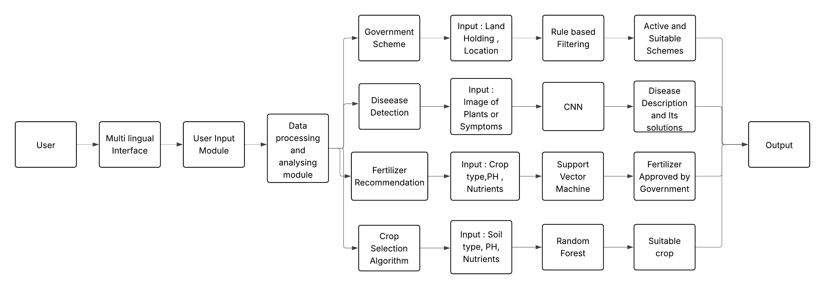
Flow Diagram

Slide 10
Tools used for implementation
Category | Tool / Technology | Purpose
Programming Language | Python | Core development language for ML models, backend logic, and data processing
Machine Learning Frameworks | Scikit-learn, TensorFlow | Building predictive models for crop, soil, irrigation, and disease detection
Computer Vision | OpenCV, TensorFlow CNN Models | Detecting crop diseases using image classification
Data Analysis Tools | Pandas, NumPy | Data preprocessing, cleaning, transformation, and analysis
Natural Language Processing (NLP) | NLTK, SpaCy,Transformers | Understanding user input and enabling local language interaction
Text-to-Speech API | Google Text-to-Speech (gTTS) | Delivering audio responses in regional languagesDelivering audio responses in regional languages
10
Notes:
10

Slide 11
Tools used for implementation
Category | Tool / Technology | Purpose
Database | Firebase | Storing user data, crop/soil information, and government scheme details
Hosting / Deployment | Railway / Render / Firebase Hosting | Deploying the application online for public access
11
Notes:
11

Slide 12
Dataset &API
✅ Crop Recommendation Dataset (India)
Source: Kaggle
✅ Fertilizer Prediction Dataset
Source: Kaggle
✅ Crop Disease Detection Dataset (PlantVillage)
Source: Kaggle
✅ Soil Data – Soil Health Card Scheme
Source: Government of India
Link: https://soilhealth.dac.gov.in/
✅ Rainfall & Irrigation Data
Source: Indian Meteorological Department (IMD)
Link: https://mausam.imd.gov.in/
✅ Water Requirement Data
Source: India WRIS Portal
Link: https://indiawris.gov.in/wris/#/
🔸 OpenWeatherMap API
Real-time weather data for irrigation and harvest planning
Link: https://openweathermap.org/api
🔸 Google Text-to-Speech API
Multilingual audio output in Indian languages
Link: https://cloud.google.com/text-to-speech
🔸 Google Translate API
Translating user queries and outputs in local languages
Link: https://cloud.google.com/translate
🔸 Government Scheme Information (Custom Integration Required)
Source:
Ministry of Agriculture - Schemes
PM-KISAN
Crop Insurance - PMFBY
🔸 State Agriculture Portals (e.g., Tamil Nadu)
Regional crop advisory and scheme access
Example: https://agri.tn.gov.in/

Slide 13
Accomplished
Accomplishment | Algorithm used
Soil Analysis | Random Forest
Fertilizer Recommendation | SVM
Disease Detection | Decision Trees

Slide 14
Future Implementation
We plan to use CNN models to detect crop diseases from images, so farmers can get instant and accurate treatment advice.
We aim to improve soil analysis accuracy using advanced data models, helping us suggest better crops and fertilizers.
We will integrate smart filtering to recommend suitable government schemes based on the farmer’s crop, region, and land size.

Slide 15
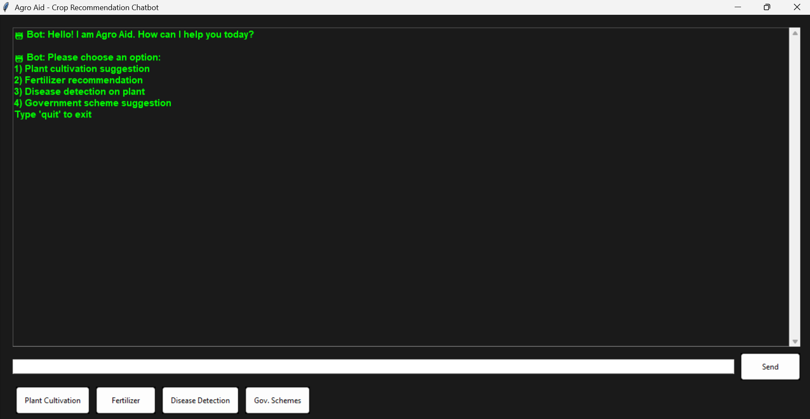
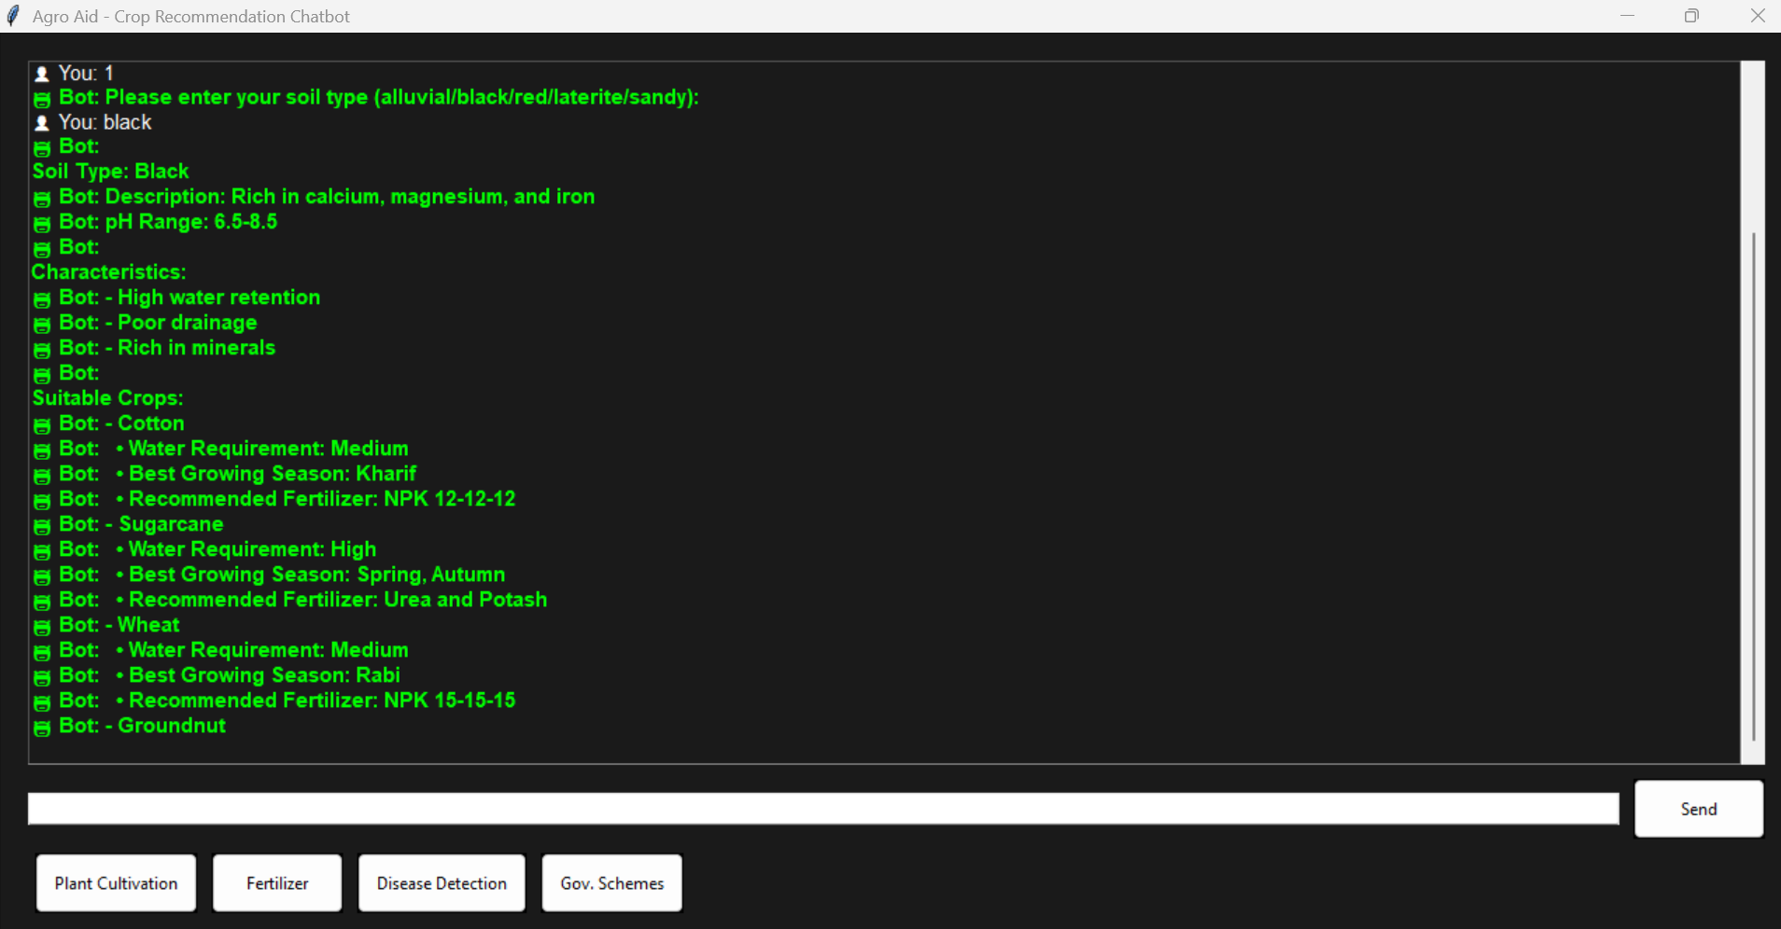
Sample Output

Slide 16
Result
AgroAid provides a smart and efficient solution to support small-scale farmers through machine learning-driven insights. The system successfully delivers accurate recommendations for crop selection, fertilizer usage, irrigation planning, and harvesting schedules based on agricultural datasets.
The image-based disease detection feature enhances crop health management by identifying issues early and suggesting timely treatments. With its multilingual NLP interface, AgroAid ensures accessibility for farmers in their regional languages, making the platform user-friendly and inclusive. Additionally, it simplifies access to relevant government schemes and subsidies through a smart filtering mechanism.
Overall, AgroAid stands out as a cost-effective, software-only solution that bridges the gap between modern technology and traditional farming, significantly boosting productivity and farmer empowerment.

Slide 17
References
Kaur, R., & Rani, P. (2021). Application of Machine Learning Techniques in Agriculture: A Review. Journal of Artificial Intelligence in Agriculture, Elsevier. https://doi.org/10.1016/j.aiia.2021.05.001
Kamilaris, A., & Prenafeta-Boldú, F. X. (2018). Deep learning in agriculture: A survey. Computers and Electronics in Agriculture, Elsevier. https://doi.org/10.1016/j.compag.2018.01.009
Singh, V., & Bhagat, A. (2020). Natural Language Processing for Agriculture Support Systems. International Journal of Advanced Computer Science and Applications (IJACSA), 11(7), 67-73. https://thesai.org/Downloads/Volume11No7/Paper_9 Natural_Language_Processing_for_Agriculture_Support_Systems.pdf
Baboo, S. S., & Kumar, R. (2019). Crop disease detection using image processing and machine learning. International Journal of Engineering Research & Technology (IJERT), Vol. 8 Issue 4.
Government of India – Ministry of Agriculture and Farmers Welfare. PM-KISAN, Soil Health Card, and Other Agricultural Schemes. https://agricoop.nic.in

Slide 18
QUERIES?☺
18

Slide 19
THANK YOU☺
19

